Slide 1

A Lightweight Health Risk Analysis App for the Elderly using Sleep Studies
Guided by,
Geetha Lekshmi V .
Anuvind MP (AM.EN.U4AIE22010)
R S Harish Kumar (AM.EN.U4AIE22042)

Slide 2
Outline
Introduction
Problem Definition
Objectives
Literature Review Summary(Table)
Research Gap
Dataset Description
Methodology / Proposed Method
Design/ Architecture
Algorithms (if any)
Evaluation Metrics
Result Analysis
Limitations
Phase II plan
Reference(APA style)
Project title

Slide 3
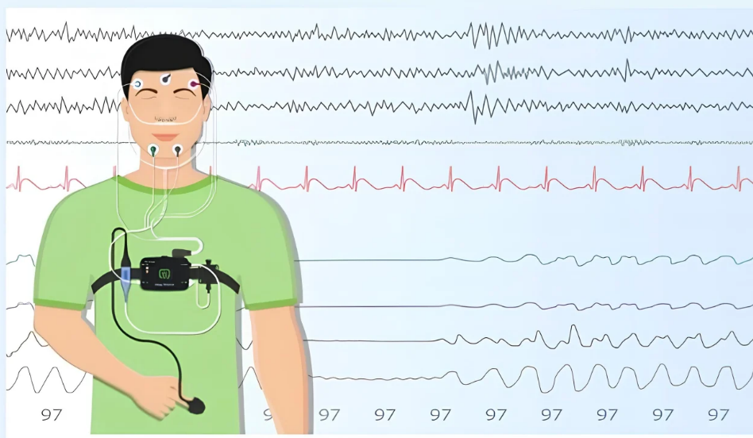
Introduction
Aging populations face increasing risk of chronic diseases.
Automated system using sleep analysis facilitates timely interventions.
Increasing healthcare costs and morbidity.
Polysomnography (PSG) provides rich multi-modal signals that capture these sleep-related physiological changes.
This can significantly reduce healthcare costs and improve quality of life for aging adults.
Notes:
Cite the work that detects dementia, Parkinson’s using polysomnography data..
Early detection through sleep analysis facilitates timely interventions – of cardiovascular disease. Dementia ,Parkinson’s???
Introduction should align with disease risk prediction, which are the systems currently using polysomnograpy data and what are the limitations?
Corrections/Modifications
Problem with sleep in elderly?? Statistics
Relation of sleep with cardio vascular disease, any info from papers??give ref also

Slide 4
Problem Definition
There is a growing need for automated health risk detection systems for elderly populations, as sleep data provides valuable indicators of cardiac, respiratory, and mental conditions. Manual PSG analysis is time-consuming, costly, and often unavailable in resource-limited regions, delaying early diagnosis.
Existing AI-based PSG models are computationally intensive and unsuitable for deployment on low-end devices. Therefore, there is a need for a lightweight, efficient, and accurate model that can operate in constrained healthcare settings.
Project title

Slide 5
Objectives
Design​‍​‌‍​‍‌ an efficient network that is easy to be installed on a low-end hardware and can contribute to green AI.
Extend the representation of the population by unifying various datasets from different groups of people.
Offer disease risk profiles especially for those which are under the spotlight of the society such as mental disorders where diagnosis is considered shameful in the Indian community.
Try different search strategies for NAS such as DARTS, RL, Genetic/Hierarchical, Random ​‍​‌‍​‍‌search.
Project title

Slide 6
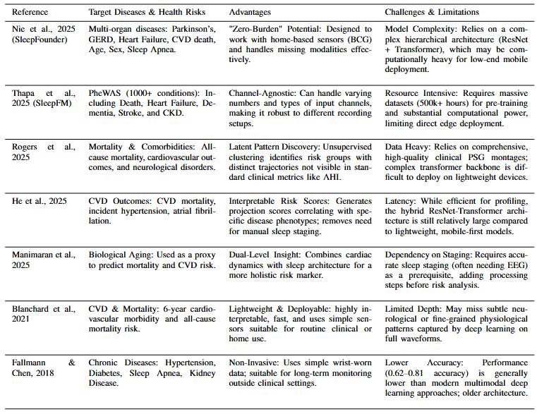
Literature Review Summary (Table)

Slide 7
Research Gap
Optimizing​‍​‌‍​‍‌ resource constraints such as memory, computation, and model complexity for health risk analysis.
Serving assistive technologies to elderly people in their early detection of diseases.
Existing systems exhibits potential bias due to underrepresented population cohorts in the training data, hence, a generalized model is needed to mitigate ​‍​‌‍​‍‌bias.

Slide 8
Dataset Description
Multiple publicly available PSG datasets were surveyed, including Cleveland Family Study (CFS), Wisconsin Sleep Cohort (WSC), MrOS Sleep Study (MROS), Sleep Heart Health Study (SHHS) and Multi-Ethnic Study of Atherosclerosis (MESA), to capture diverse populations and acquisition protocols.​
A common multimodal PSG representation was defined by identifying seven channels consistently available across these datasets: EEG, EOG, ECG, EMG, leg movement, thoracic movement, and SpO₂, ensuring cross-dataset compatibility.​
The current phase focuses on the Cleveland Family Study (CFS) dataset, using its PSG recordings and clinical labels to build cardiac, respiratory, and mental health risk detection system.

Slide 9
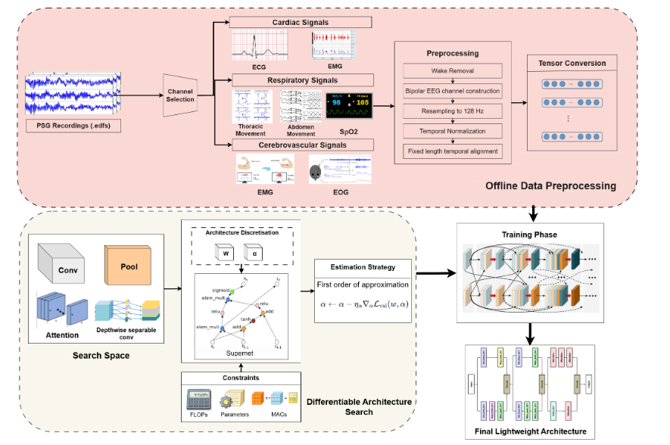
Methodology

Slide 10
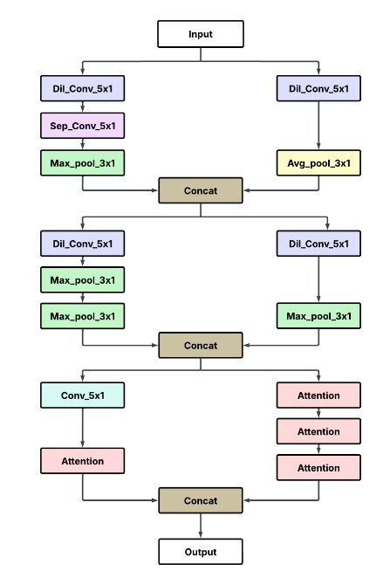
Optimal light-weight Architecture
Multi-branch feature extraction: The NAS-designed block combines dilated convolutions, separable convolutions, and pooling to capture features at multiple receptive fields.
Progressive fusion: Intermediate features are repeatedly concatenated, enabling richer representation learning across stages.
Attention-enhanced output: Stacked attention modules refine important features before final aggregation, improving focus on salient patterns.

Slide 11
Methodology

Slide 12
Evaluation Metrics
1. Classification Performance (Multi-label, Imbalanced Data)
ROC Curves: Measure diagnostic discrimination across thresholds
Precision–Recall Curves: Emphasize performance on rare disease conditions
Confusion Matrices: TP, TN, FP, FN analysis per disease (D = 20)
2. Computational Efficiency (Lightweight Constraints)
FLOPs: Forward-pass computational complexity
MACs: Arithmetic operation cost
Parameter Count: Trainable weights (regularized during NAS)

Slide 13
Result Analysis
Search Convergence & Stability
Training loss decreased steadily (0.348 → 0.289), with stable validation loss (~0.312), indicating reliable convergence.
Best validation accuracy: 90.6%, with a small train–val gap, suggesting good generalization and no supernet overfitting.
Efficiency–Performance Trade-off
FLOPs increased gradually (1.28×10⁸ → 1.67×10⁸), correlating with accuracy gains.
Discovered Architecture Characteristics
Multi-scale parallel branches capture temporal features at different resolutions.
Dilated 5×1 convolutions dominate, expanding receptive field without parameter growth.
Stacked attention blocks integrate local temporal patterns with global context.

Slide 14
Result Analysis
Cardiovascular:
Hypertension: High sensitivity (224 TP), AUC ≈ 0.90, strong ECG-based discrimination.
Irregular heartbeat: High specificity (TN > 700), effective detection of clear arrhythmia cases.
Respiratory:
Asthma & bronchitis show very high specificity (TN > 650), driven by RIP signals.
Mental Health:
ADHD detection is robust, with sustained precision in PR curves using EEG features.
Class Imbalance Effects
Rare conditions (e.g., stroke, myocardial infarction) show step-like PR behavior due to limited positive samples in CFS.

Slide 15
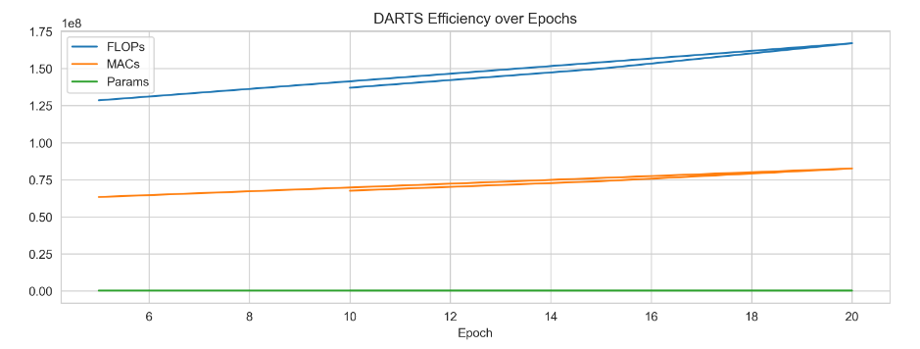
Result Analysis

Slide 16
Limitations
Class​‍​‌‍​‍‌ Imbalance Sensitivity: The effectiveness of the system goes down for rare comorbidities (like myocardial infarction, stroke) as the number of positives is very low.
Bias toward Majority Classes: The NAS search goal is to increase the overall accuracy, hence the result is that the model is mostly tuned on the majority of the frequent disease labels in the multi-label settings.
Reduced Sensitivity for Rare Events: Overall, the framework is highly efficient and accurate, but it exhibits lower recall for rare acute ​‍​‌‍​‍‌conditions.

Slide 17
Phase 2 Plan
Data Expansion & Validation: Integrate large multi-center cohorts (WSC, SHHS, MESA, APPLES, MrOS) to improve robustness, address class imbalance, and enhance cross-cohort generalization.
Clinical Desktop Application: Develop a user-friendly desktop tool enabling clinicians to upload raw EDF files and receive automated risk assessments without requiring Python expertise.
Deployment & Packaging: Package the optimized model and application into a single executable for seamless installation on standard clinical workstations, including low-end systems.

Slide 18
References(APA Style)
Kim, Y., Jang, T. G., Park, S. Y., Park, H. Y., Lee, J. A., Oyun-Erdene, T., ... & Urtnasan, E. (2025). Multimodal AI-approach for the automatic screening of cardiovascular diseases based on nocturnal physiological signals. npj Cardiovascular Health, 2(1), 15.
Lee, H., Choi, Y. R., Lee, H. K., Jeong, J., Hong, J., Shin, H. W., & Kim, H. S. (2025). Explainable vision transformer for automatic visual sleep staging on multimodal PSG signals. npj Digital Medicine, 8(1), 55.
Zhang, Z., Lin, B. S., Peng, C. W., & Lin, B. S. (2024). Multi-modal sleep stage classification with two-stream encoder-decoder. IEEE Transactions on Neural Systems and Rehabilitation Engineering, 32, 2096-2105.
Liu, R., Li, J., Wen, Y., Huang, X., Sheng, B., Feng, D. D., & Zhang, P. (2025). MHFNet: a multimodal hybrid-embedding fusion network for automatic sleep staging. IEEE Journal of Biomedical and Health Informatics.
Jiang, X., Zhao, J., Du, B., & Yuan, Z. (2021, July). Self-supervised contrastive learning for EEG-based sleep staging. In 2021 International Joint Conference on Neural Networks (IJCNN) (pp. 1-8). IEEE.

Slide 19
References(APA Style)
Weng, W., Gu, Y., Guo, S., Ma, Y., Yang, Z., Liu, Y., & Chen, Y. (2025). Self-supervised learning for electroencephalogram: A systematic survey. ACM Computing Surveys, 57(12), 1-38.
LeCun, Y., Bengio, Y., & Hinton, G. (2015). Deep learning. nature, 521(7553), 436-444.
Nie, G., Chen, X., Wang, Y., Chen, J., Shi, Y., Zhong, J., ... & Leng, Y. (2025). A Zero-Burden Sleep Foundation Model Built on Cardiorespiratory Signals from 800,000+ Hours of Multi-Ethnic Sleep Recordings. medRxiv, 2025-09.
Kjaer, M. R., Thapa, R., Ganjoo, G., Moore IV, H., Jennum, P. J., Westover, B. M., ... & Brink-Kjaer, A. (2025). Stanford Sleep Bench: Evaluating Polysomnography Pre-training Methods for Sleep Foundation Models. arXiv preprint arXiv:2512.09591.
Thapa, R., Kjær, M. R., He, B., Covert, I., Moore, H., Hanif, U., ... & Zou, J. (2025). A multimodal sleep foundation model developed with 500k hours of sleep recordings for disease predictions. medRxiv.

Slide 20
References(APA Style)
Weng, W., Gu, Y., Guo, S., Ma, Y., Yang, Z., Liu, Y., & Chen, Y. (2025). Self-supervised learning for electroencephalogram: A systematic survey. ACM Computing Surveys, 57(12), 1-38.
LeCun, Y., Bengio, Y., & Hinton, G. (2015). Deep learning. nature, 521(7553), 436-444.
Nie, G., Chen, X., Wang, Y., Chen, J., Shi, Y., Zhong, J., ... & Leng, Y. (2025). A Zero-Burden Sleep Foundation Model Built on Cardiorespiratory Signals from 800,000+ Hours of Multi-Ethnic Sleep Recordings. medRxiv, 2025-09.
Kjaer, M. R., Thapa, R., Ganjoo, G., Moore IV, H., Jennum, P. J., Westover, B. M., ... & Brink-Kjaer, A. (2025). Stanford Sleep Bench: Evaluating Polysomnography Pre-training Methods for Sleep Foundation Models. arXiv preprint arXiv:2512.09591.
Thapa, R., Kjær, M. R., He, B., Covert, I., Moore, H., Hanif, U., ... & Zou, J. (2025). A multimodal sleep foundation model developed with 500k hours of sleep recordings for disease predictions. medRxiv.

Slide 21
References(APA Style)
Bilal, E., Araujo, M. L. D., Beck, K. L., Heinzinger, C. M., Ghosn, S., Saab, C. Y., ... & Mehra, R. (2025). A Foundation Model for Sleep-Based Risk Stratification and Clinical Outcomes. Research Square, rs-3.
He, Z., Li, H., Yuan, G., Killgore, W. D., Quan, S. F., Chen, C. X., & Li, A. (2025). Multimodal Cardiovascular Risk Profiling Using Self-Supervised Learning of Polysomnography. SLEEPJ, zsaf371.
Manimaran, G., Puthusserypady, S., Dominguez, H., & Bardram, J. E. (2025). Cardiovascular Risk Assessment via Sleep Patterns and ECG-Based Biological Age Estimation. Journal of Clinical Medicine, 14(10), 3339.
Blanchard, M., Feuilloy, M., Gervès-Pinquié, C., Trzepizur, W., Meslier, N., Goupil, F., ... & ERMES study group. (2021). Cardiovascular risk and mortality prediction in patients suspected of sleep apnea: a model based on an artificial intelligence system. Physiological Measurement, 42(10), 105010.
Fallmann, S., & Chen, L. (2018, November). Detecting chronic diseases from sleep-wake behaviour and clinical features. In 2018 5th international conference on systems and informatics (ICSAI) (pp. 1076-1084). IEEE.

